Slide 1
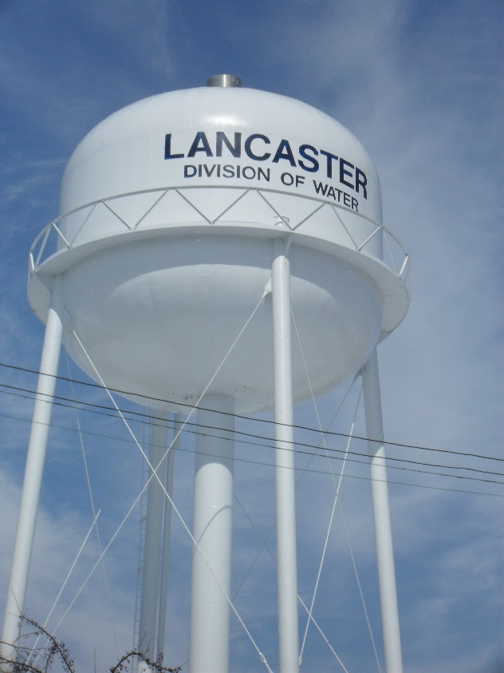
North Water Plant Replacement
Water Treatment for the 21st Century
April 12, 2021

Slide 2
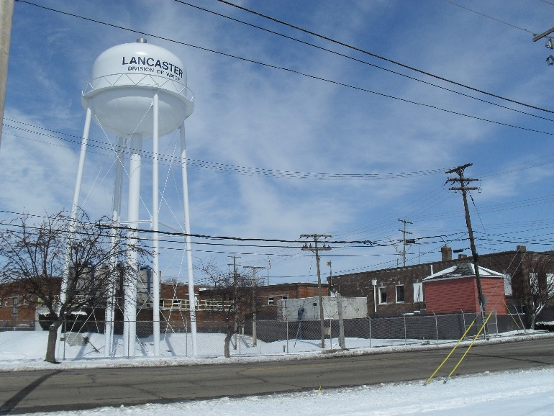
Current Situation
Miller Park Water Treatment Plant
Built 1925
Expanded 1976
Current Production: 2.44 MGD (2019 Avg)
Wellfield Capacity: 9.3 MGD
Treatment: Aeration, Filtration, Zeolite Softening, Disinfection

Slide 3
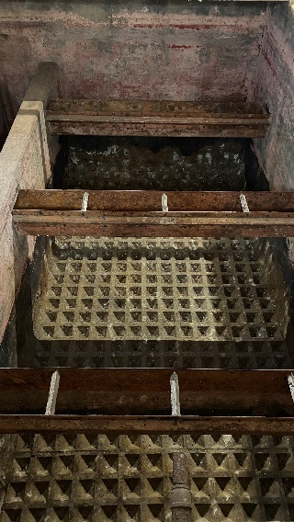
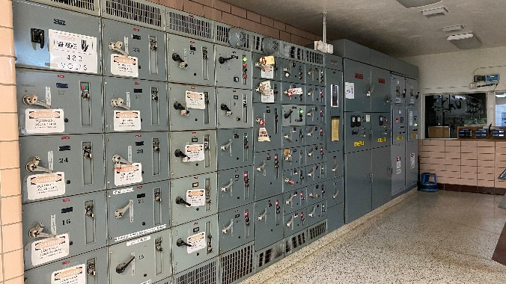
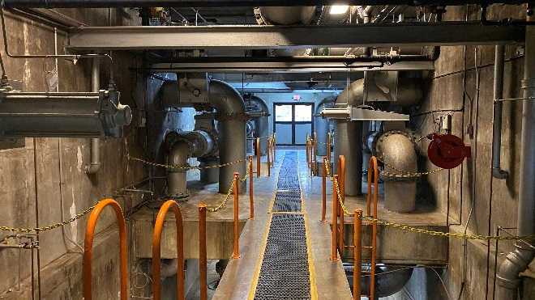
Reasons to Expand
Age and Increased Maintenance Costs
Increased Water Demands in US 33 Service Area
Changes in Water Quality Needs
Future Treatment for Emerging Contaminants
Interest Rates

Slide 4
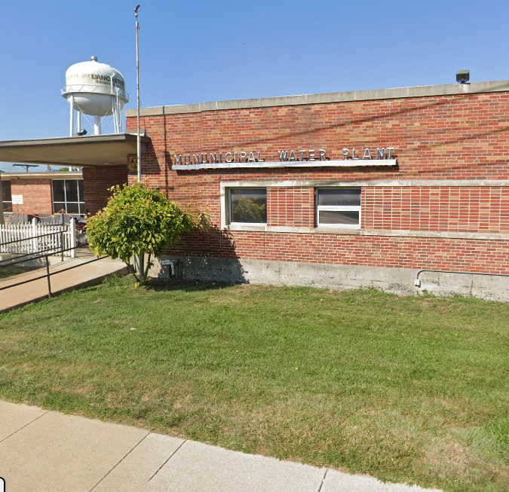
Option 1
Renovate Existing Plant
Pros
Existing Wellfield
Connection to Existing System
Wellhead Protection Area
Cons
Age
Maintenance of Operations
Treatment Options

Slide 5
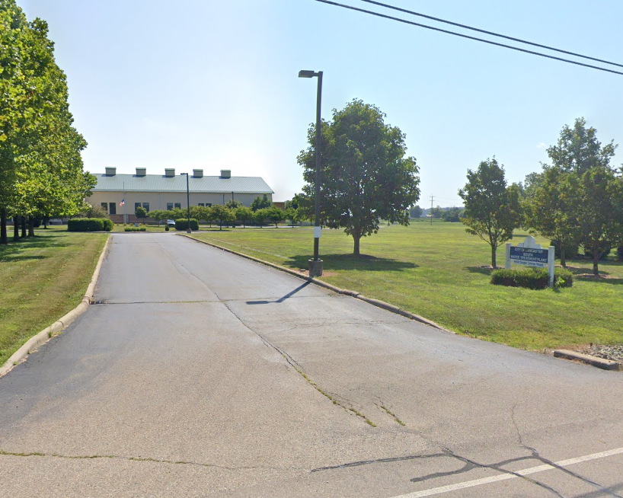
Option 2 Expand the South Treatment Plant
Pros
Existing Wellfield
Room to Expand
Treatment Process
Cons
Less Protected Wellfield
Maintenance of Operations
Limited Connection of Distribution System
Future Expansion Site

Slide 6
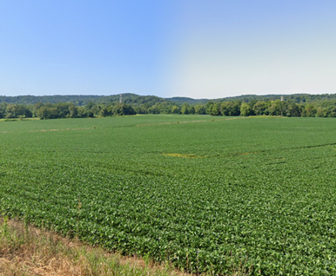
Option 3 Develop a New Wellfield and Treatment Plant
Pros
Moves Wellfield from City
Cons
Less Protected Wellfield
Limited Connection of Distribution System
Other Land Uses
Cost to Purchase and Develop Wellfield
Wastewater and CSO considerations
Development Time

Slide 7
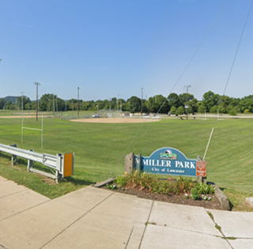
Option 4 Construct New Treatment Plant at Miller Park
Pros
Existing Wellfield and Wellhead Protection Area
Connections to existing Distribution System
Maintain Existing Plant Operations
Cons
Loss of Land for other uses
Wellfield in Center of City

Slide 8
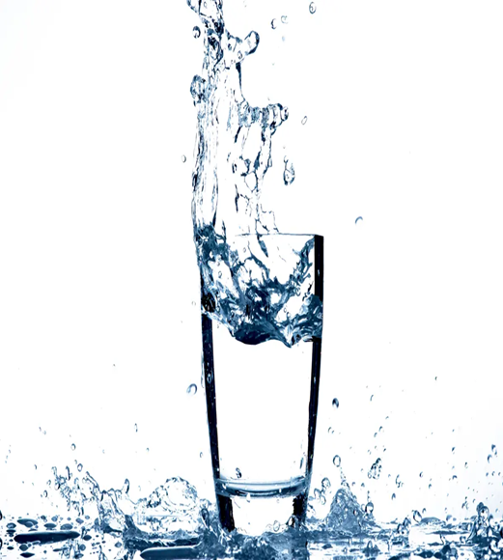
Treatment Techologies
Aeration
Filtration
Softening
Ion Exchange
Lime Soda
Membrane Treatment
Disinfection

Slide 9
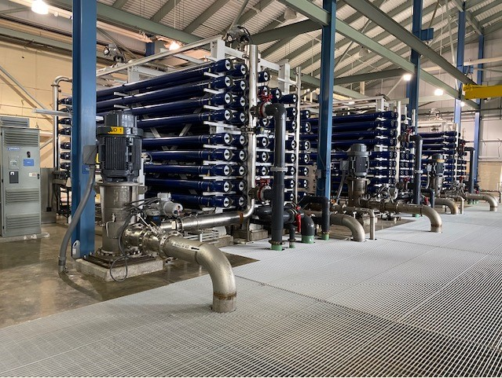
Selected Alternative
Use Existing Wellfield
Construct New Water Plant at North End of Miller Park
Utilize Membrane Filtration for Improved Water Quality

Slide 10
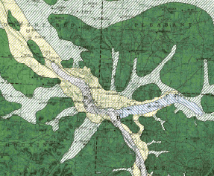
Reasons for Selection
Existing Wellfield
No land acquisition
Connect to existing distribution system
Existing Wellhead Protection Area
Redundant Water Production from 2 Plants
Discharge of Concentrate Waste
Improved Water Quality
Standardize Operations where possible

Slide 11
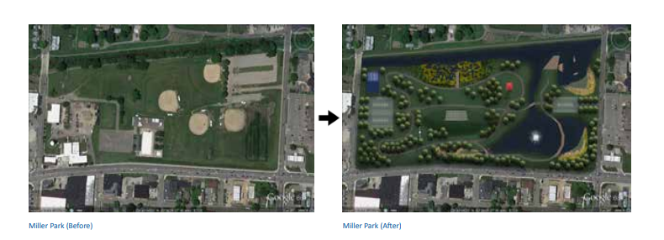
Impacts on Miller Park
Coordination with Lancaster Park and Recreation
Parks planned to move athletic fields and create passive recreation area
Master Plan for Miller Park after North Plant Footprint determined (Summer of 2021)

Slide 12
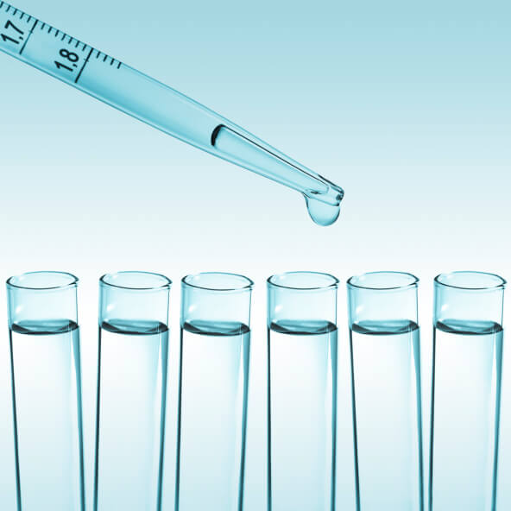
Treatment Technology
21st Century Treatment Technology
Prepare to address emerging contaminates
Reducing Dissolved Solids and Sodium in finished water

Slide 13
Cost
Initial Study Project Cost $40 Million
Bond Anticipation Notes-Study
OWDA Loans-Design ($2.5 Million) and Construction $35 Million
OWDA Interest Rate Current 0.6%

Slide 14
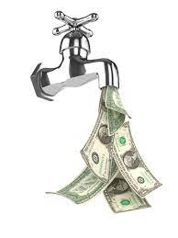
Effect on Rates
South Water Plant Debt-Retired in 2022
Operation Costs-Membrane Filtration Less to Operate
New Loan Payment Starts 2026
Bond Retirement-Bonds Retire in 2029
Interest Rates-Current Low Rates
Increased Industrial Customers in US 33 Service Area
Expected User Charge Changes-Too soon to Predict

Slide 15
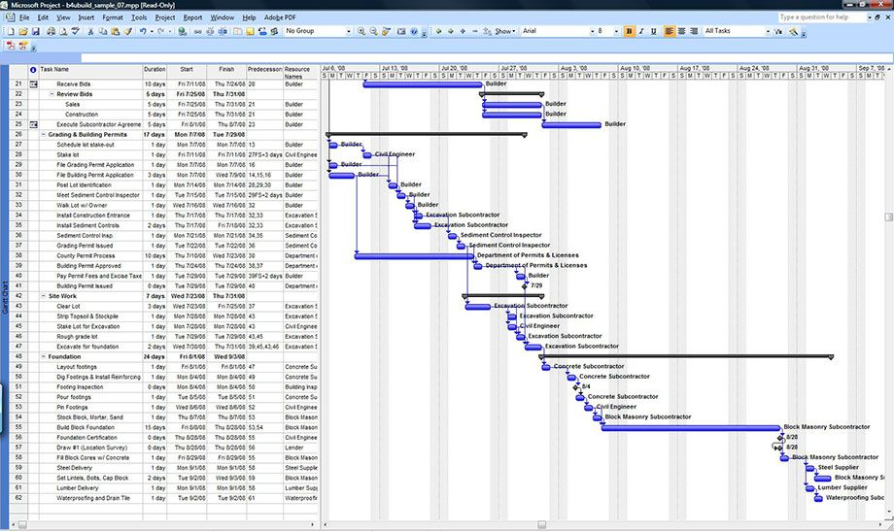
Schedule
Study February-May 2021
Design May 2021-February 2022
Construction July 2022-July 2024
Operation July 1, 2024

Slide 16
Comments
Send Comments by April 30, 2021
Send to Steven Wellstead
121 E. Chestnut St Suite 100
Lancaster Ohio 43130
swellstead@ci.lancaster.oh.us

Slide 17

Questions

